Slide 1

LIVING ORGANISMS
are of two types
Unicellular
Multicellular
Made up of single cell
Made up of many cells
For E.g. Amoeba
For E.g. Human beings and plants
All functions performed by the same cell
Different functions are performed by different cells
This is known as Division of labour

Slide 2

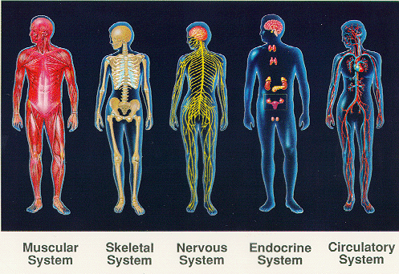
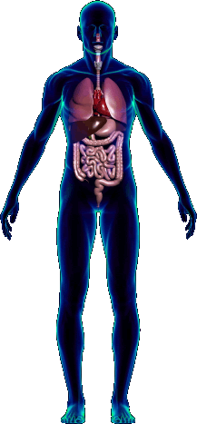
Every multicellular living body consists of :
Tissues come together to form different organs.
Cell
Tissues
Cell is the basic unit of life.
Cells divide to form group of cells called as tissues.
Different tissues perform different functions.
Organ
All organs performing same function come together to form organ systems.
Organ Systems
Organism
All organ systems together form an organism.

Slide 3
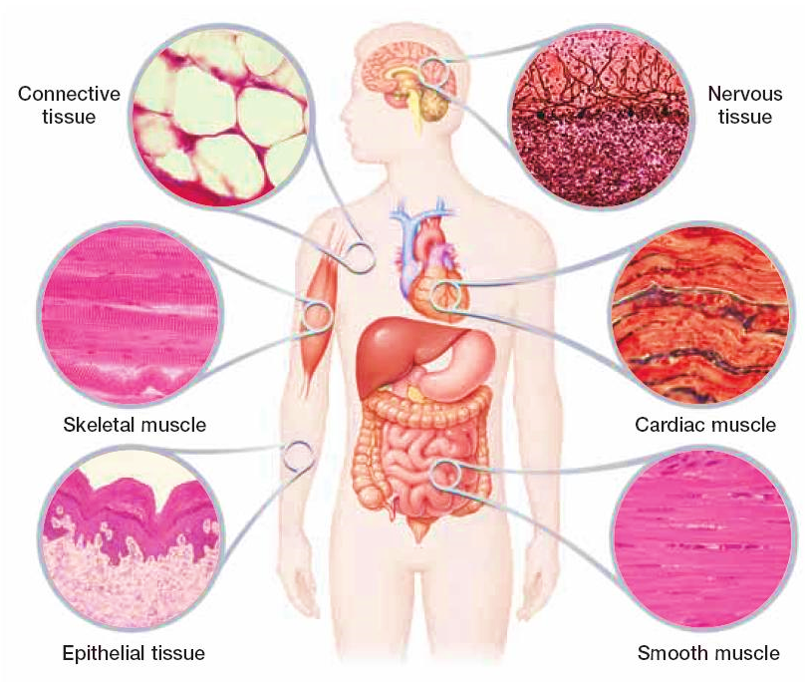
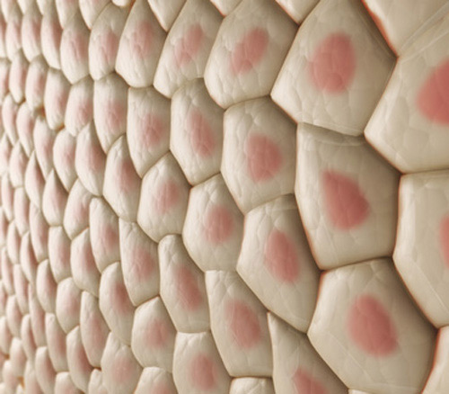
So, we saw that tissue is a group of cells performing a specialized function.
A group of cells that are similar in structure and/or work together to achieve a particular function forms a tissue.
So how do we
define a tissue?

